Slide 1

Mechanistic models in macroecology and biodiversity science
Petr Keil

Slide 2
Modelling complex nature with complex models
Agent-based (individual-based) models

Slide 3
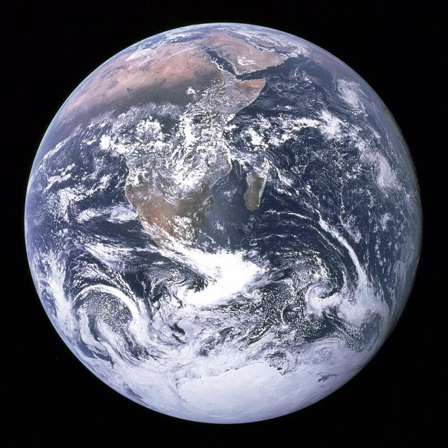
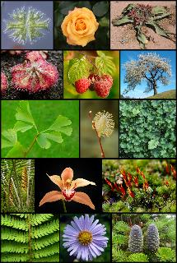
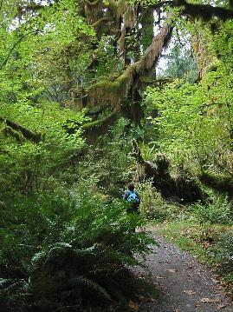
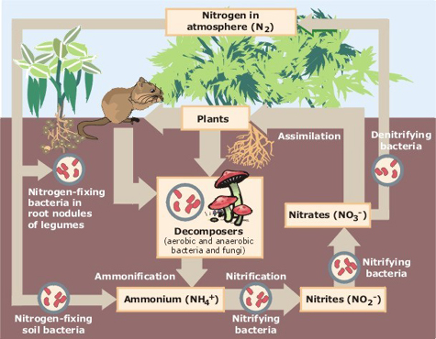
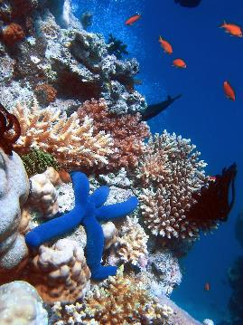
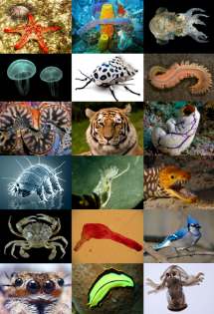
Nature is complex and we can’t always do experiments
Images: Wikimedia Commons

Slide 4
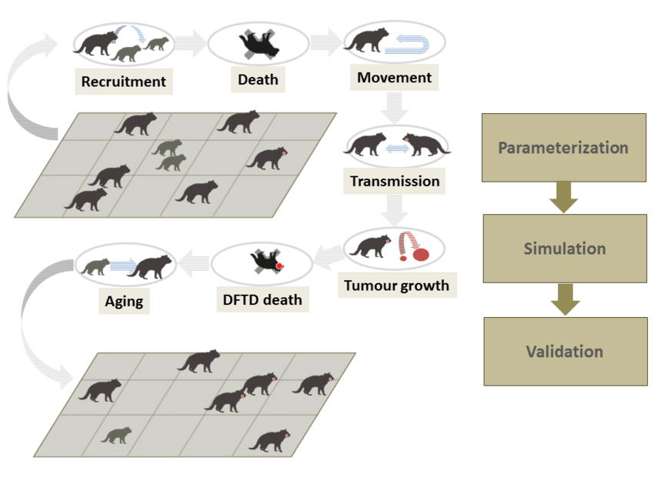
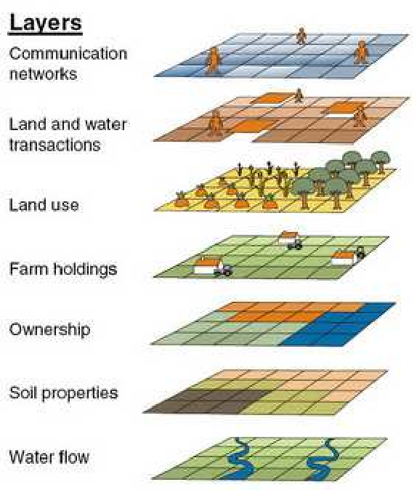
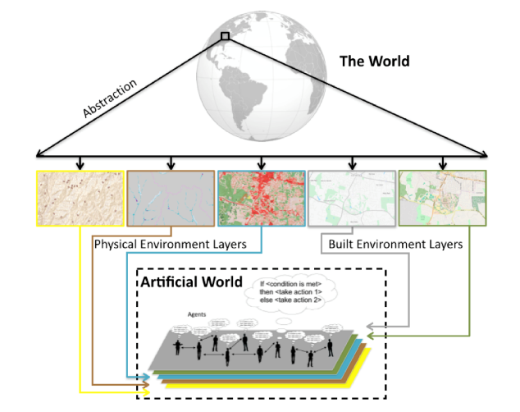

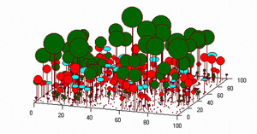

Simulation models: Agent-based models
Agent-based (or individual-based) models are complex models that simulate complex reality. They have high level of detail.
Grimm et al. (2005) Individual-based modelling in ecology

Slide 5
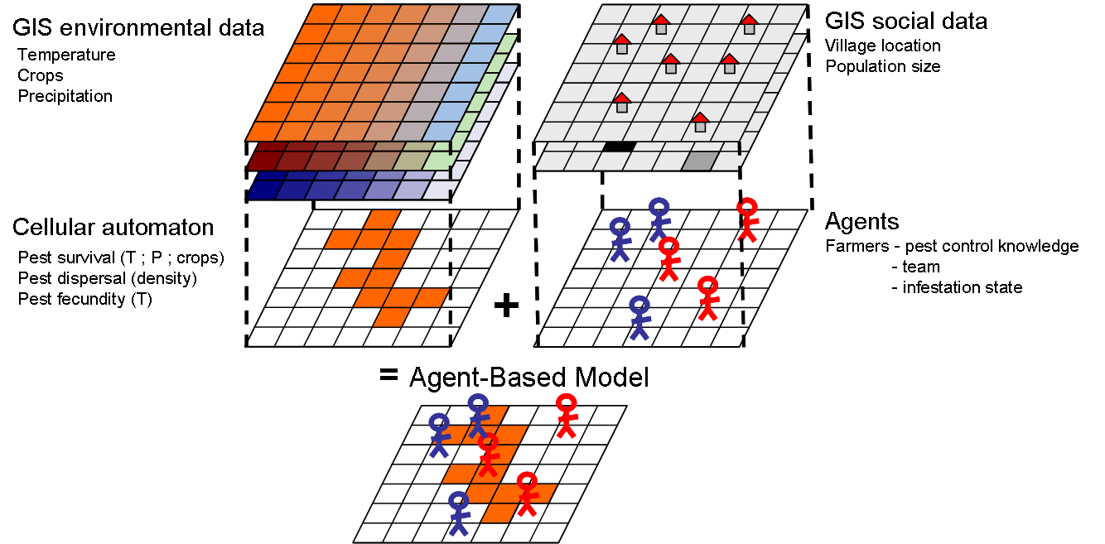
Simulation models: Agent-based models
Agent-based models can combine artificial rules with real-world inputs (e.g. GIS rasters)
Rebaudo et al. (2011) Agent-based modelling of human-induced spread of invasive species in agricultural landscapes. Journal of Artificial Societies and Social Simulation

Slide 6
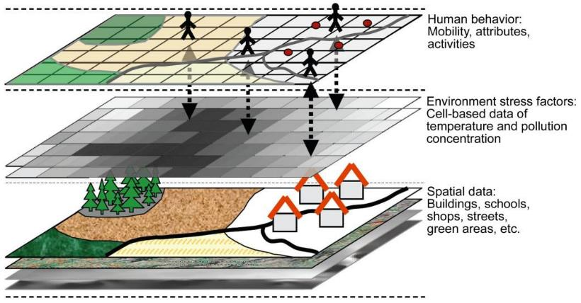
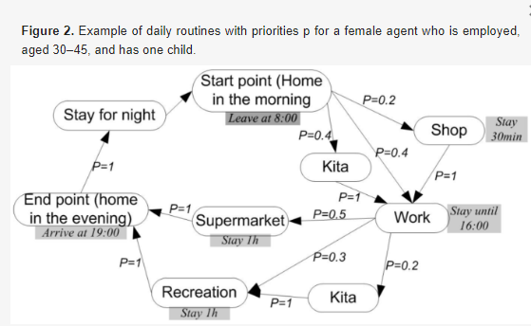
Simulation models: Agent-based models
Agent-based models can combine artificial rules with real-world inputs (e.g. GIS rasters)
human exposure to environmental
Yang et al. (2018) An agent-based modeling framework for simulating human exposure to environmental stresses in urban areas. Urban Science

Slide 7
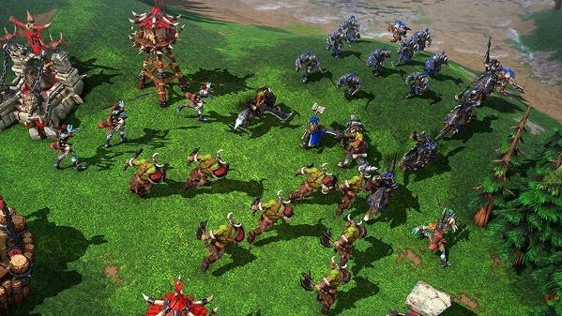
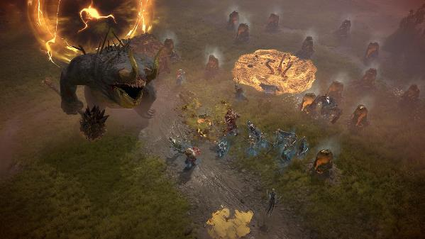

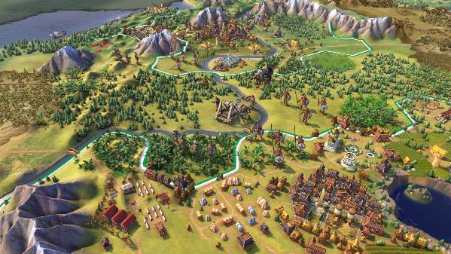
Simulation models: Agent-based models
They seem similar to computer games (agents may have their own intelligence to behave realistically)

Slide 8
Simulation models: Agent-based models
The good:
- We can explore behavior of complex systems that would otherwise be impossible to do experiments with (e.g. human epidemiology, ecology, …)
The bad:
- Too many parameters and agents make it difficult to verify and validate against reality
- The same behavior (pattern) can emerge from all sorts of models
- Many behaviors can emerge from a slight modification of the same model
- Model outputs are difficult to generalize outside of the specific modelling context

Slide 9
From simple rules to complex patterns
Cellular automata, fractals, deterministic chaos

Slide 10
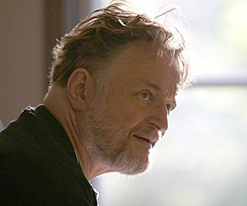
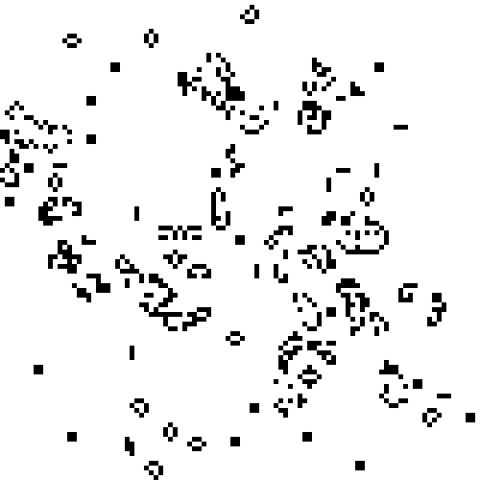
Conway’s Game of Life – simple rules
John Horton Conway
(1937-2020)

Slide 11
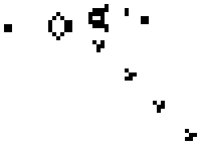
Conway’s Game of Life – simple rules
Any live cell with fewer than two live neighbours dies, as if by underpopulation.
Any live cell with two or three live neighbours lives on to the next generation.
Any live cell with more than three live neighbours dies, as if by overpopulation.
Any dead cell with exactly three live neighbours becomes a live cell, as if by reproduction.

Slide 12
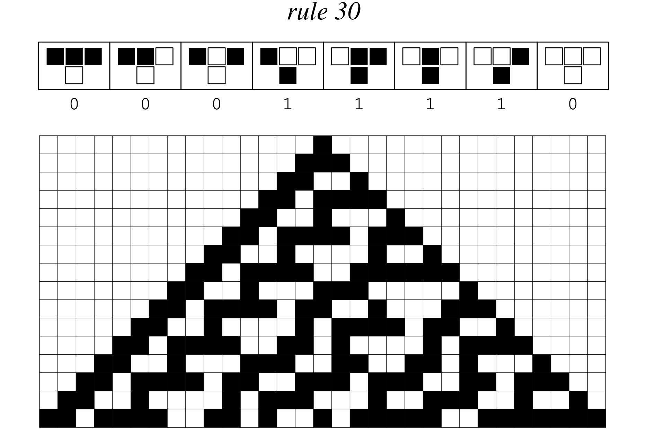
One-dimensional cellular automata
Wolfram MathWorld

Slide 13
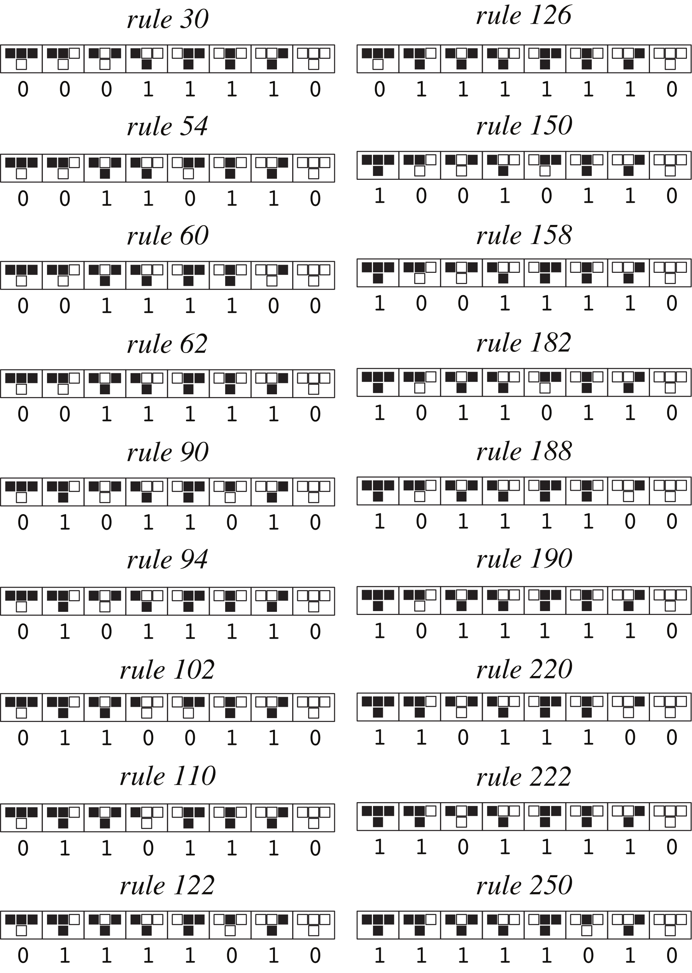
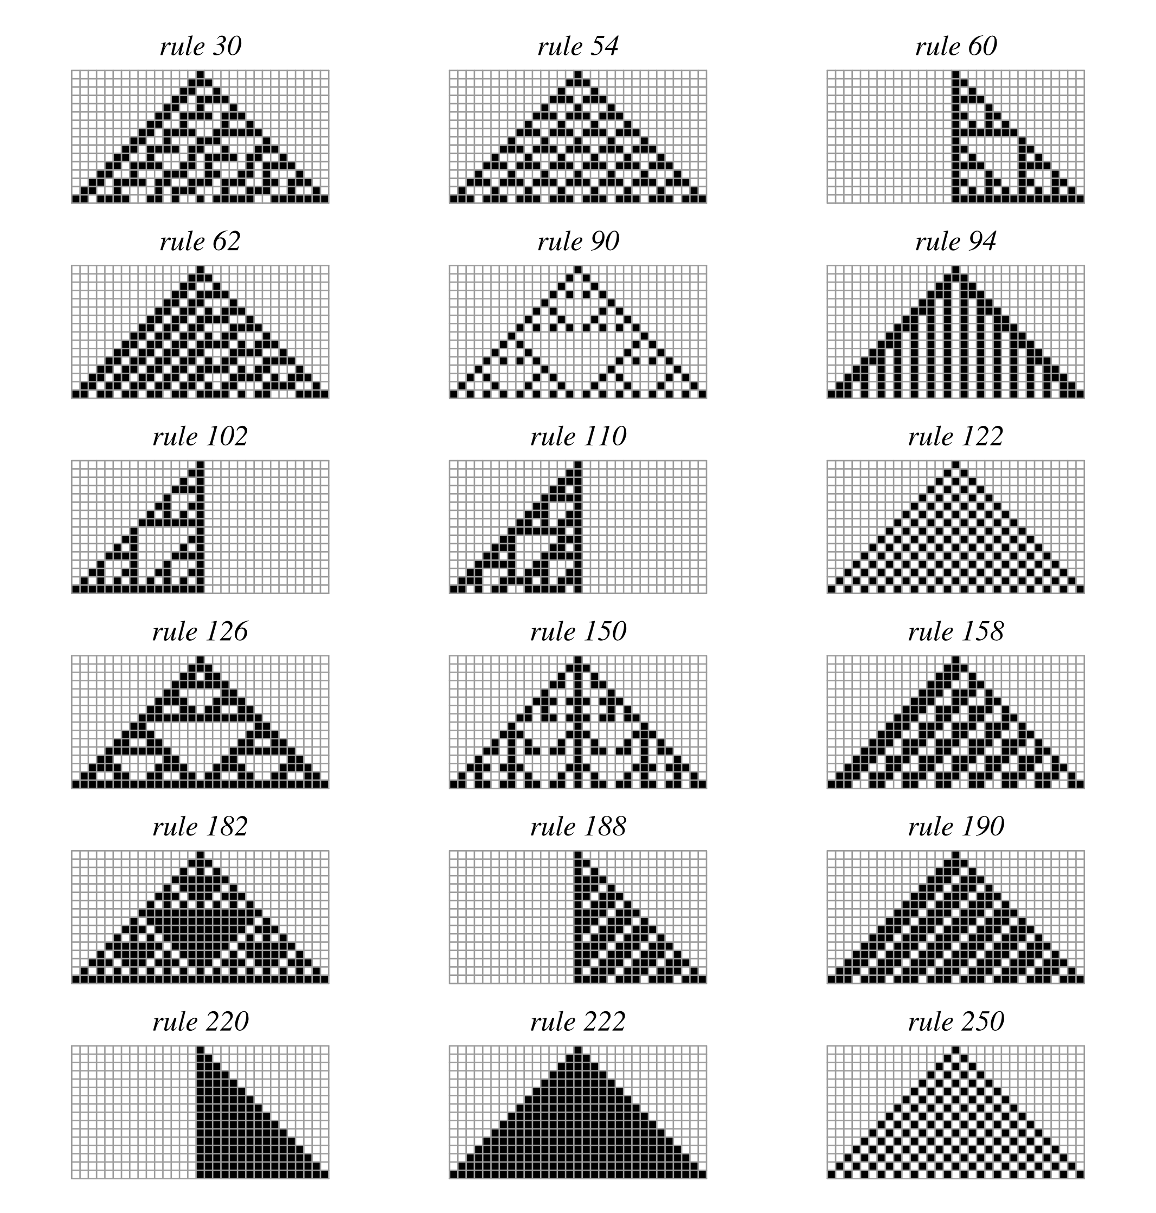
One-dimensional cellular automata
Wolfram MathWorld

Slide 14
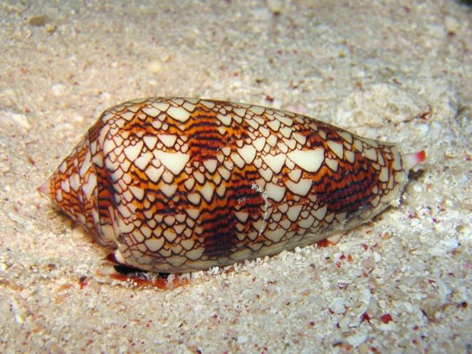
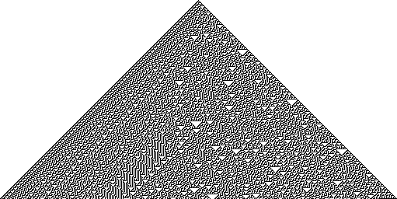
One-dimensional cellular automata
Conus abbas (homolice)
Cellular automaton “rule 30”
Liana Manukyan (1995) Nature

Slide 15
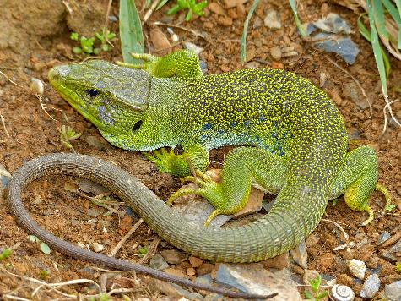
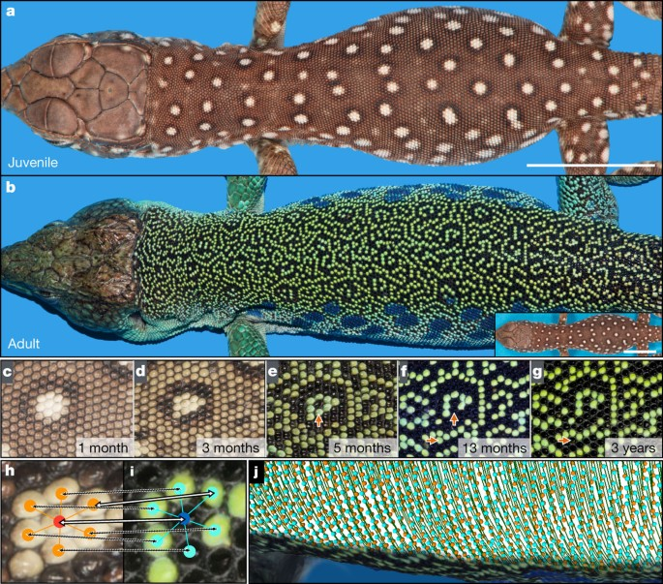
Cellular automata in nature
Manukyan et al. (2017) Nature
Timon lepidus (Ocellated lizard)

Slide 16
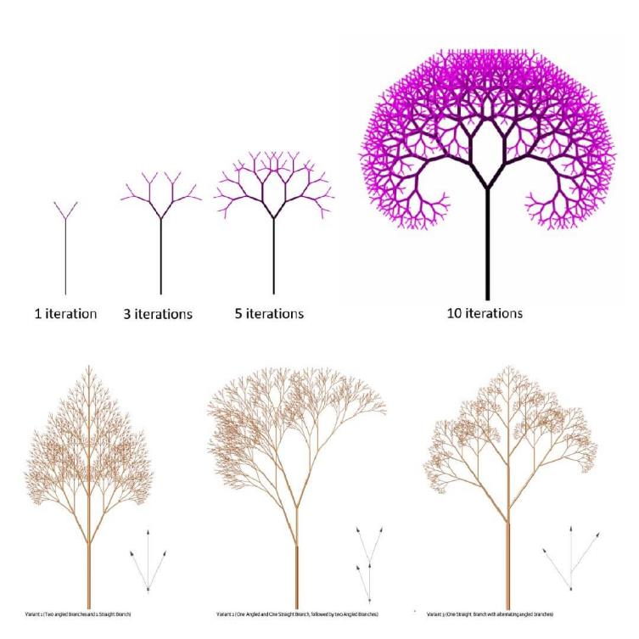
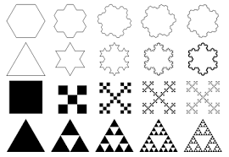
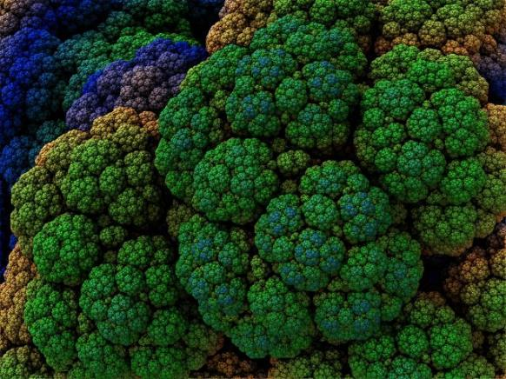
Fractals – another case of simple rules but complex outcomes

Slide 17
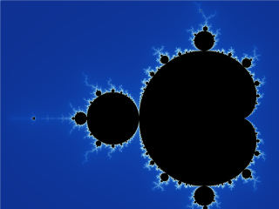
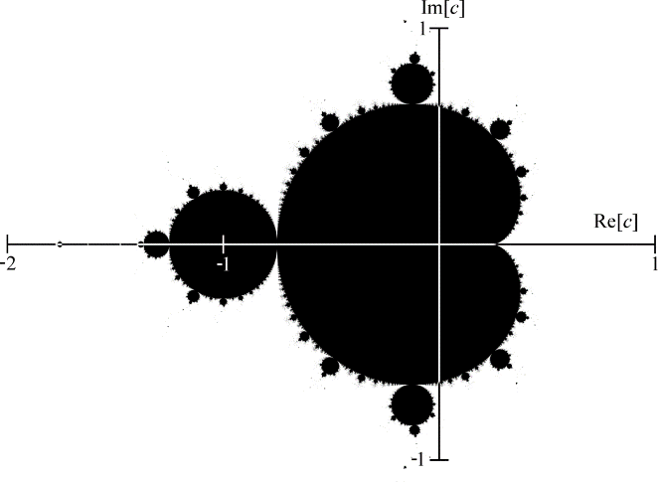
Fractals – another case of simple rules but complex outcomes
Mandelbrot set. Images: Wikimedia Commons

Slide 18
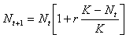
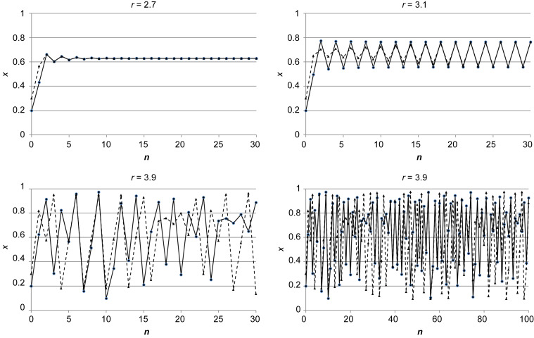
Chaotic behavior of logistic equation – from sigmoidal curve to deterministic chaos
Population size (N)
Time step (t)

Slide 19
What you should know
That complex and seemingly unpredictable (“alive”) structures can emerge from simple rules
What are cellular automata, and give an example of their operation from real world
That fractals and deterministic chaos are examples of complex structures emerging from simple rules
There are individual-based (agent-based) models, which use complex rules to reproduce complex behavior

Slide 20
Unified Neutral Theory of Biodiversity
The cellular automaton for community ecology. The simplest model of nature.

Slide 21
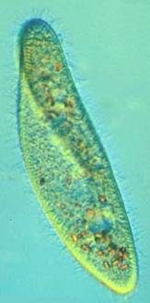
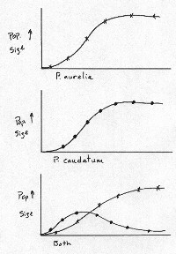
Gause’s principle of competitive exclusion
Two species or populations cannot inhabit the same niche: one will consistently out-compete the other.
When one species has even the slightest advantage over another, the one with the advantage will dominate in the long term.
Complete competitors can not coexist.
So how can species coexist?
Paramecium caudatum
vs. P. aurelia
Gause G. F. (1932) Journal of Experimental Biology

Slide 22
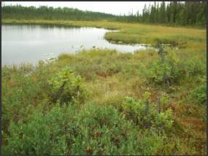
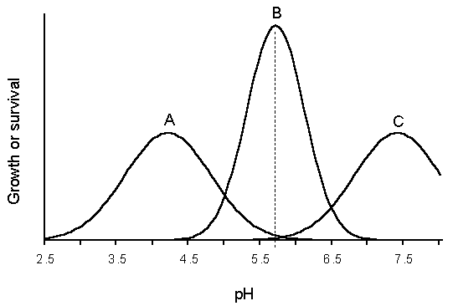
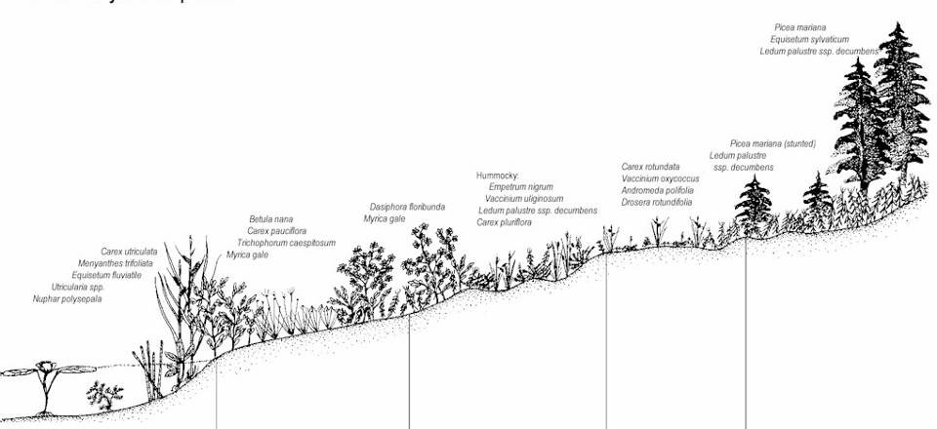
Hcan species coexist? Thanks to heterogeneity of environment and niche differences
Humididy gradient

Slide 23
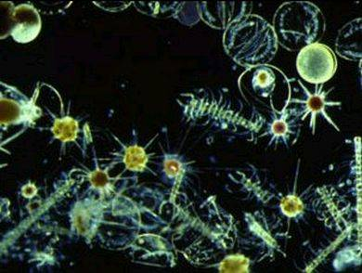
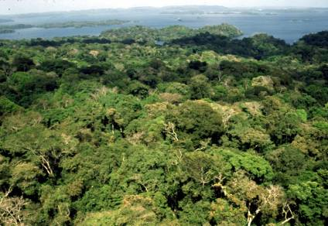
But, there is the paradox of the plankton, tropical forests …
Many species with similar niches coexist in homogeneous environments. How is that possible?
Hutchinson (1961)

Slide 24
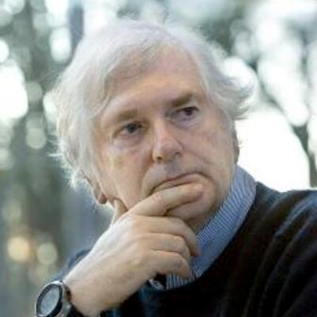
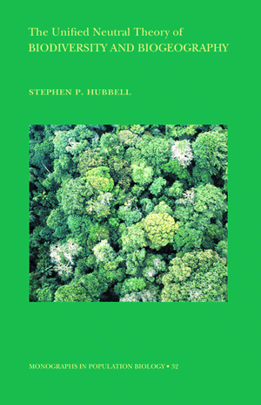
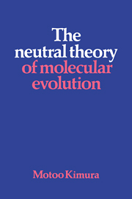
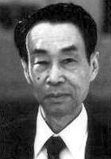
Paradox of the plankton, tropical forests
Motoo Kimura
Stephen P. Hubbell
UCLA
Kimura (1983) The neutral theory of molecular evolution
Hubbell (2001) The Unified Neutral Theory of Biodiversity and Biogeography

Slide 25
A neutral model
Metacommunity
Local community

Slide 26
A neutral model
Metacommunity
1. Mortality (disturbance)
Local community

Slide 27
A classic neutral model
Metacommunity
1. Mortality (disturbance)
Local community

Slide 28
A classic neutral model
Metacommunity
1. Mortality (disturbance)
Local community
2. Colonization
(from within the local community, and from other communities)
3. Speciation
(an existing species splits to two)

Slide 29
A classic neutral model
Metacommunity
1. Mortality (disturbance)
Local community
2. Colonization
(from within the local community, and from other communities)
3. Speciation
(an existing species splits to two)

Slide 30
Variants of the neutral model: The spatially explicit neutral model (on infinite landscapes)
Rosindell et al. (2011) Trends in Ecology & Evolution

Slide 31
The neutral model produces realistic patterns (sometimes)
Rosindell et al. (2011) Trends in Ecology & Evolution

Slide 32
What you should know
According to Gause’s principle of competitive exclusion, two species with similar niches should not be able to coexist in a homogeneous environment
Environmental heterogeneity and niche differences enable coexistence
But there is the paradox of the plankton, where similar species coexist in homogeneous environment
The unified neutral theory of biodiversity (UNTB) offers a cellular automaton that resolves the paradox
UNTB sometimes predicts realistic shapes of species-area relationship and species-abundance distributions

Slide 33
Other null models
Random walk, Mid-domain effect

Slide 34
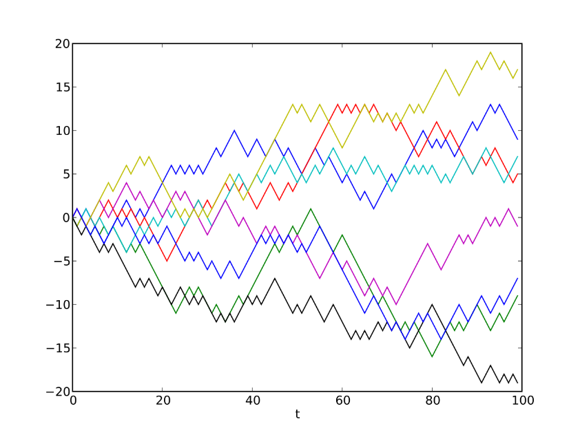
The random walk
A random walk, sometimes known as a drunkard's walk, is a random process that describes a path that consists of a succession of random steps on some mathematical space.
An elementary example of a random walk is the random walk which starts at 0, and at each step moves +1 or −1 with equal probability.
Images: Wikimedia Commons
Coding et al. (2008) Random walk models in biology. J. Royal Soc. Interface

Slide 35
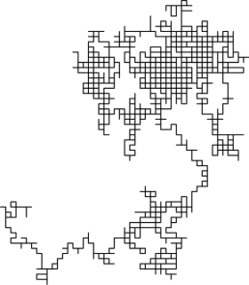
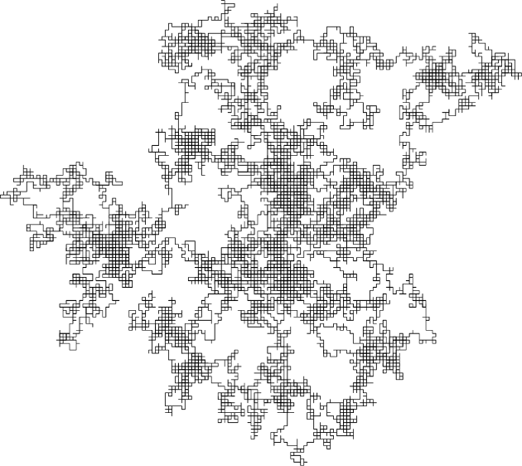
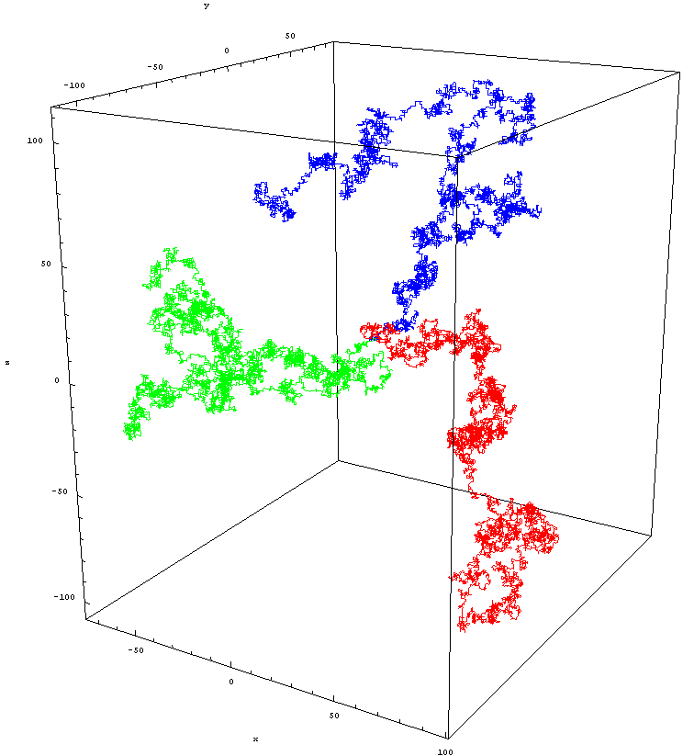
The random walk
Images: Wikimedia Commons

Slide 36
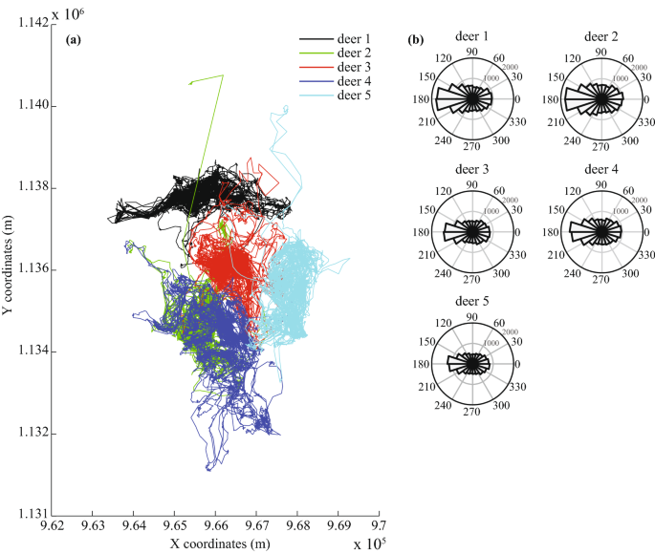
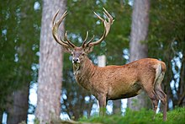
The random walk – a null model for the study of animal movement
Berthelot et al. (2021) Sci. Rep.

Slide 37

The random walk – a null model for population dynamics or trait evolution

Slide 38

The mid-domain effect – example of a pattern that emerges from purely geometrical reasons
The increasing overlap of species ranges towards the centre of a shared geographic domain due to geometric boundary constraints in relation to the distribution of species' range sizes and midpoints.
Colwell & Lees (2000) Trends in Ecology & Evolution

Slide 39

Elevational gradient of species richness
Rahbek (1995) Ecography

Slide 40
What is a null model?
In mathematics, for example in the study of statistical properties of graphs, a null model matches one specific pattern in some of its features, or more generally satisfies a collection of constraints, but which is otherwise taken to be an unbiasedly random structure.
In ecology, null models are usually the simplest models that can be derived from first principles and constraints. They usually contain very little biology.
Null models can serve as a foundation for our understanding of nature. If the null model reproduces the empirically observed patterns, then do we need biology/ecology at all?
They can also be the simplest computational frame (vehicle) on which we can build more complex models.
Random walk and random range placement (the mid-domain effect model) is an example of a simple model that reproduces the hump-shaped pattern of species richness along elevation. The model is also wrong, by the way (Sizling, Storch & Keil 2011, Ecology).

Slide 41
Thank you. Questions?

